Slide 1

MODERN COMPUTING FOR PHYSICS
N-BODIES SIMULATION WITH
GPU PARALLELIZATION

Slide 2
The n-bodies problem
We consider a system of n bodies, each with a given mass, initial position, and initial velocity
The bodies interact solely through gravitational forces
We want to simulate their time evolution, obtaining their trajectories
We want to check the conservation of total energy
Computational cost O(n²)

Slide 3
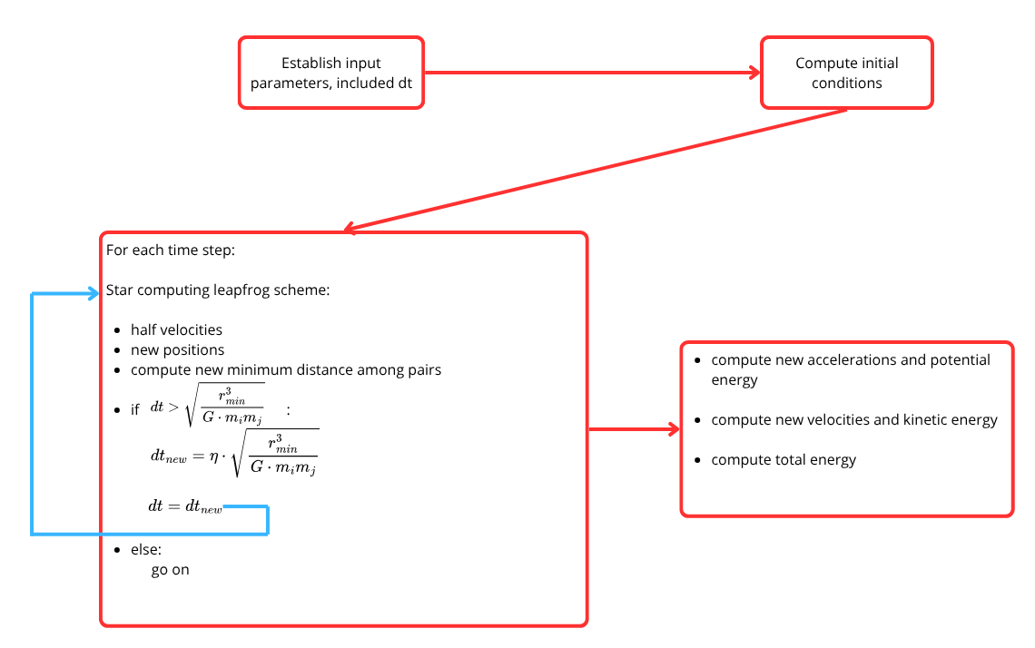
Serial code in C

Slide 4
Issues: scale of the problem and data types
This scale is chosen such that:
-we can graphycally observe trajectories: gravitational forces daminatig over rectilinear uniform motion) and proportioned in the space
-the numerical scheme is stable
-you can compile with both float or double precision
#ifdef FLOAT
typedef float real;
#define SQRT sqrtf
#define FMOD fmodf
#else
typedef double real;
#define SQRT sqrt
#define FMOD fmod
#endif
#define n_bodies 6
#define steps 1500000
#define SRAND 31265
const float dt_max = 1e-6f;
const float eta = 1e-3f;
const float L = 100.0f;
const float G = 1.0e3f;
for (int i = 0; i < n_bodies; i++) {
m[i] = rand_interval(1.0f, 10.0f);
x[i] = rand_interval(0.3f * L, 0.7f * L);
y[i] = rand_interval(0.3f * L, 0.7f * L);
z[i] = rand_interval(0.3f * L, 0.7f * L);
vx[i] = rand_interval(-1.0f, 1.0f);
vy[i] = rand_interval(-1.0f, 1.0f);
vz[i] = rand_interval(-1.0f, 1.0f);
}

Slide 5
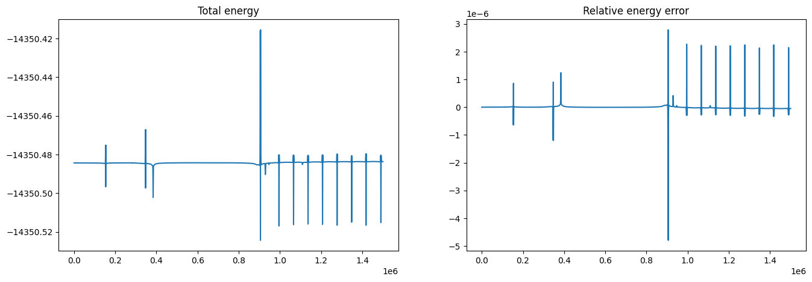
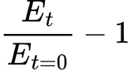
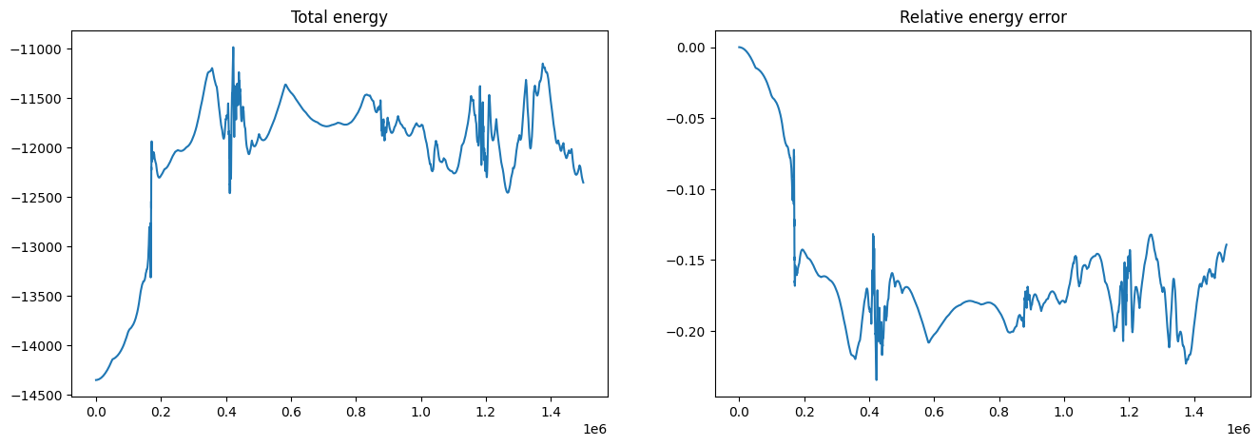
Evolution of total energy of the system
Double precision
relative errors ~10⁻⁶
Relative errors:
Float precision:
unstable

Slide 6
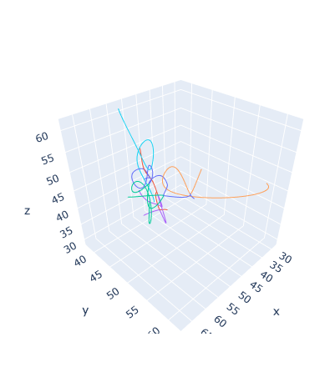
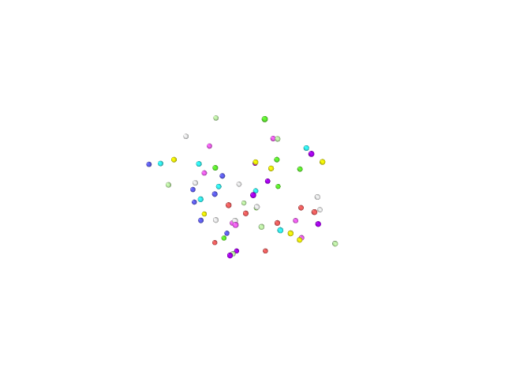
6 bodies trajectories 64 bodies (with periodic boundary conditions)
In the code a csv file to keep track of the positions has been created as output. Trajectories have been plotten in python from this file with a script written by generative AI. The csv has been modified through a script and be animated through OVITO.

Slide 7
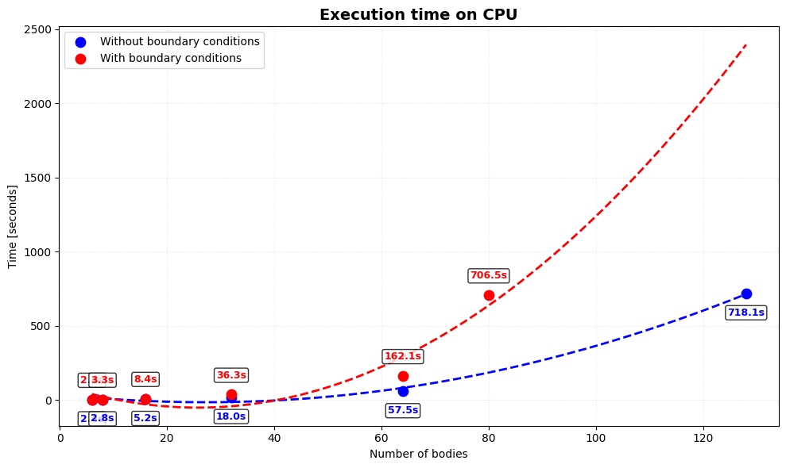

Slide 8
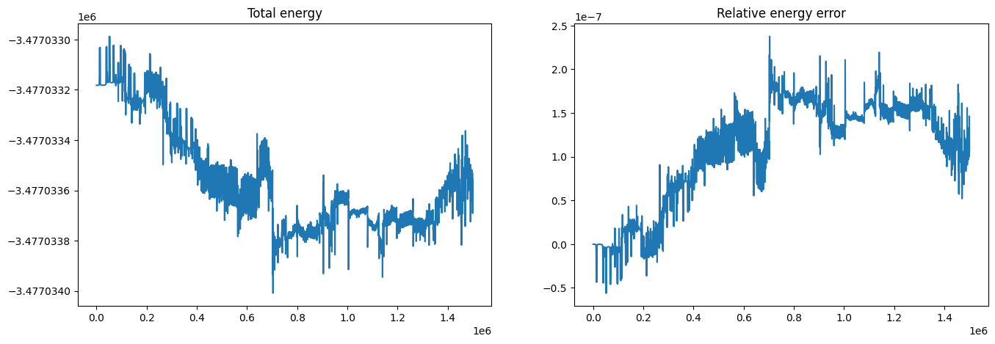
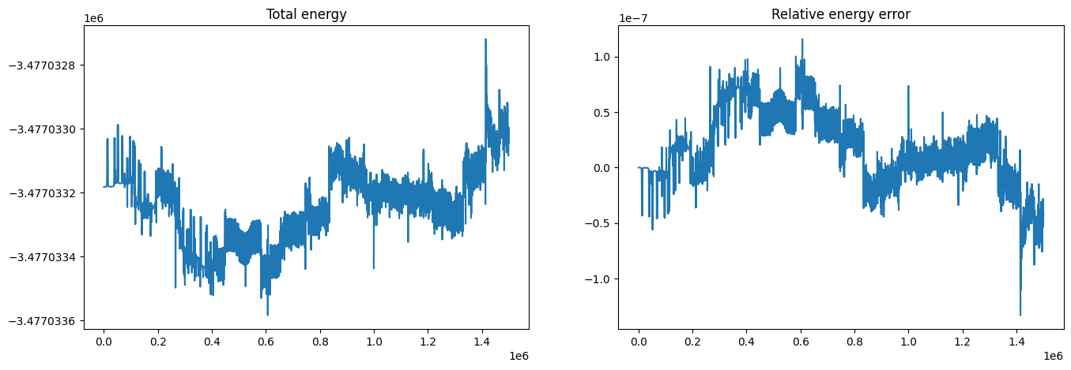
Conservation of energy for a 64 bodies system and 1500k steps
With periodic boundary conditions
Without boundary conditions

Slide 9
Parallel code in CUDA
GPU Tesla T4
Global Memory 15360 MiB
Streaming MultiProcessors 40
Total CUDA Cores 2560
Max Threads per Block 1024
Shared Memory per SM 64 KB
Compute Capability 7.5

Slide 10
Crucial point is updating the accelerations of the bodies
tiling strategy is used, using the approach suggested in
https://developer.nvidia.com/gpugems/gpugems3/part-v-physics-simulation/chapter-31-fast-n-body-simulation-cuda
We may think the algorithm as calculating each entry a_{ij} in an NxN grid of all pair-wise forces.
Then the total acceleration a_{i} on body i is obtained from the sum of all entries in row i.
O(N²) would be too large
We introduce tiles, square regions of the grid pxp
Boundary conditions not applied

Slide 11
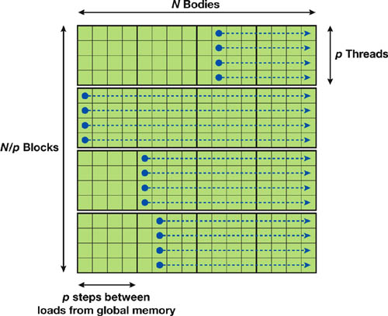
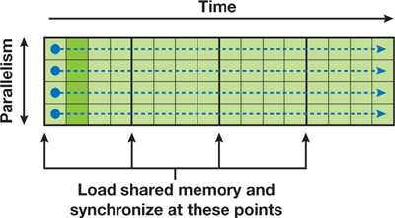
The properties of the bodies are written in shared memory of the blocks for each dimension of the grid.
Each row corresponds to a thread which computes sequentially interactions with the bodies in the columns, summing up accelerations sequentially.
A final sum is computed among all tiles.
The problem's symmetry can’t be exploited, the real advantage is the reduction of accesses to global memory.

Slide 12
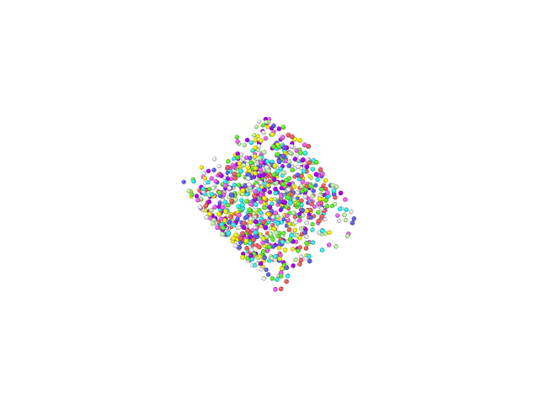
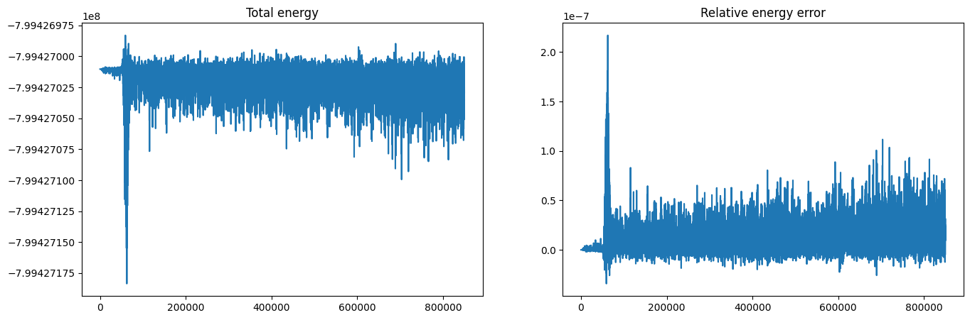
The algorithm preservs conservation of energy also with 1024 bodies Relative errors ~10⁻⁷

Slide 13
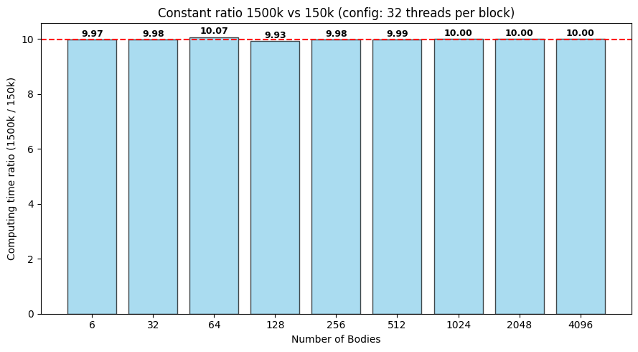
Execution time is linear with respect to the numer of steps.

Slide 14
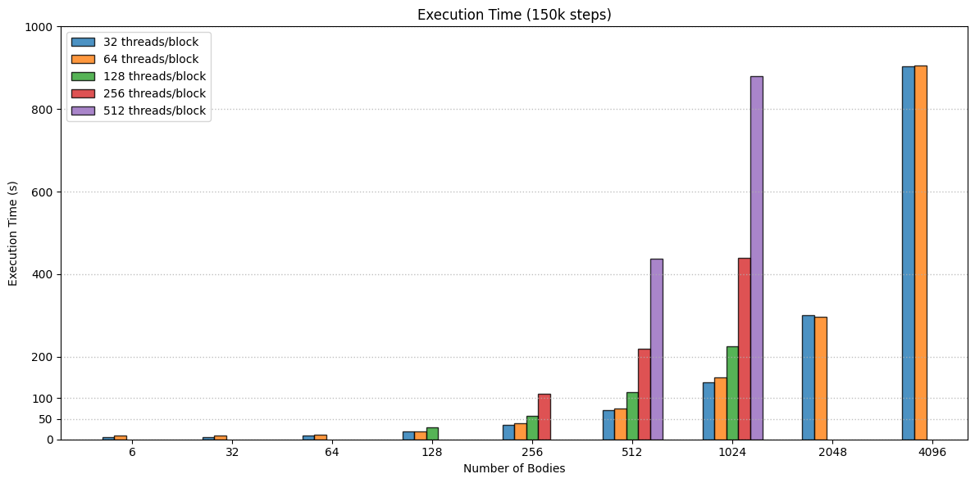
n_blocks=n_bodies/thr_per_b Having more blocks hides latency due to memory transfers.

Slide 15
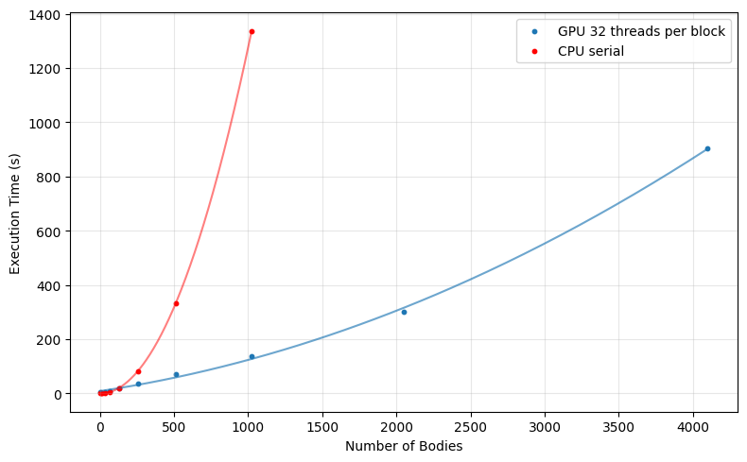

Slide 16
